Slide 1

Impact and analysis of various cache design choices on CPU performance using gem5 simulator
Team Members:
Saumya Shah (sxs220366)
Deep Padmani (dmp210005)

Slide 2
What is cache?
It is smaller and faster memory that stores frequently accessed data or instructions
It reduces the memory access time of the processors.
There could be multi-level caches (L1, L2) in a processor each with different speeds, sizes and access times.
In multilevel cache hierarchy the L1 is the smallest but fastest cache located on the same chip as the processor.
L2 is larger and slower, can or can’t be on the same chip as the processor.
Caches help improve the overall speed and efficiency of a computer system by reducing the time to access data and instructions

Slide 3
Project requirements and specifications
Objective
Fine-tune the cache hierarchy on X86 architecture based on the gem5
simulator by changing the parameters of cache design
Tools used
gem5 simulator
Mobaxterm: for remote access
Benchmarks: 456.hmmr, 458.sjeng
Script: created a python script for run_project2.py the project

Slide 4
Deliverables
Calculate the CPI for a set of benchmarks
Optimize CPI for each benchmark
Define a cost function for the caches
Define an Evaluation function using CPI and Cost function
Graph of CPI vs Cost for designs

Slide 5
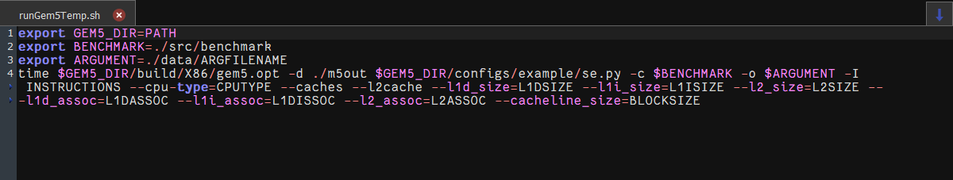
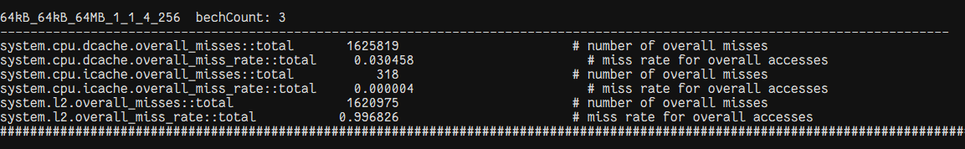
Calculate CPI
We have made the following changes in the runGem5.sh of the benchmarks 456.hmmer and 458.sjeng.
We stored the values in a separate file and calculated the CPI for each benchmark

Slide 6
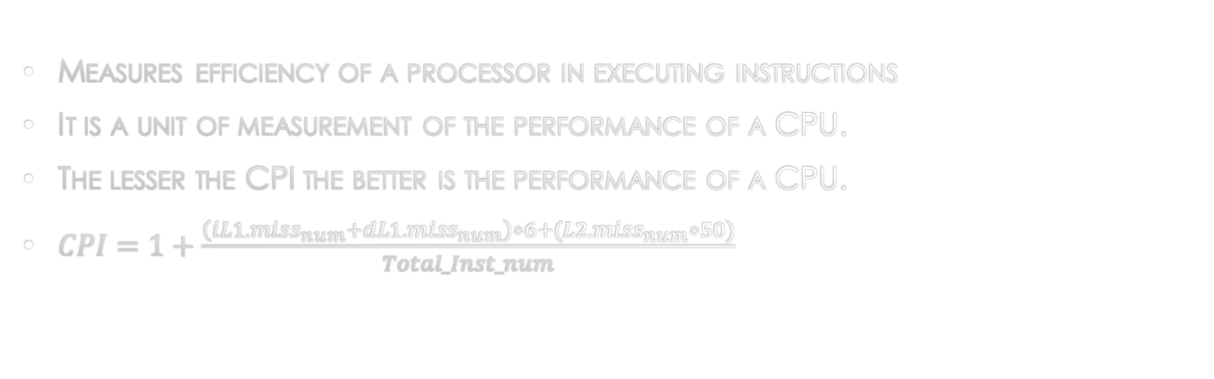
Clock cycle per instruction (cpi) calculations
Measures efficiency of a processor in executing instructions
It is a unit of measurement of the performance of a CPU.
The lesser the CPI the better is the performance of a CPU.
$CPI=1+\frac{\left(iL1.miss_{num}+dL1.miss_{num}\right)∗6+(L2.miss_{num}∗50)}{Total_Inst_num}$

Slide 7

Clock cycle per instruction (cpi) calculations (continued)
Benchmark 458.sjeng
system.cpu.dcache.overall_misses::total 819476
system.cpu.icache.overall_misses::total 440
system.l2.overall_misses::total 810645
$$CPI=1+\frac{\left(819476+440\right)∗6+(810645∗50)}{500000000}$$
CPI=1.090903

Slide 8

Clock cycle per instruction (cpi) calculations (continued)
Benchmark 458.hmmer
system.cpu.dcache.overall_misses::total 151765
system.cpu.icache.overall_misses::total 3266
system.l2.overall_misses::total 845
$$CPI=1+\frac{\left(151765+3266\right)∗6+(845∗50)}{500000000}$$
CPI=1.001945

Slide 9
CPI for each benchmark
BENCHMARKS | L1 d sizes range | L1 i sizes range | L2 sizes range | L1 d Asso. range | L1 i Asso. range | L2 Asso. range | Cache size range
456.Hmmr | 64,128 | 64,128 | 64,128 | 1,4,8 | 1,4,8 | 1,4,8 | 256,512
458.sjeng | 64,128 | 64,128 | 64,128 | 1,4,8 | 1,4,8 | 1,4,8 | 256,512

Slide 10
458.Sjeng CPI vs. configurations

Slide 11
456.Hmmer cpi vs configurations

Slide 12
Observations
CPI decreases
as L1 & L2 Cache Size increases.
as L1 & L2 Associativity increases
performance increases
Optimal configuration – Lowest CPI
For 456.hmmer
L1.d = 128kB, L1.i = 128kB, L2 = 64MB, L1.d Associativity = 8, L1.i Associativity =8,L2 Associativity = 4, Cache Size = 512; the CPI is 1.000125.
For 458.sjeng
L1.d = 128kB, L1.i = 128kB, L2 = 128MB, L1.d Associativity = 1, L1.i Associativity =1, L2 Associativity = 4, Cache Size = 512 ; the CPI is 1.061851.

Slide 13
Cache cost function
Conditions considered for getting the Cost Function
Cost Function is directly Proportional to cache size; that implies larger the cache, higher the cost.
Cost function is directly proportional to the associativity of cache i.e. More the associativity higher the cost
L1 caches are costlier than L2 Caches therefore cost of L1 will be more.

Slide 14
L1 size | Cost
64 kB | 128 $
128 kB | 256 $
L1 Cache: From the table, we can see that the cost of the Cache doubles when the Cache size doubles.
L1 Associativity: We can see from the table that direct mapped cache costs 1$ and as the associativity increases, the cost also increases.
L2 size | Cost
64 MB | 96 $
128 MB | 192 $
L1 associativity | Cost
1 | 3 $
4 | 12 $
8 | 24 $
L2 Cache: L2 Cache is relatively cheaper than L1. The cost doubles as the Cache size doubles.
L2 Associativity: We can see from the table that directly mapped cache costs 1$ and as the associativity increases, the cost also increases.
L2 associativity | Cost
1 | 2 $
4 | 8 $
8 | 16 $

Slide 15
456.hmmer: COST vs CPI
The configuration with the lowest cost CPI = 1.001192 [l1d_size = 64KB, l1d_size = 64KB, l2_size = 64MB, l1 d_assoc = 1, l1 i_assoc = 1, l2_assoc = 1, cache size = 256]
Cost = $360
The configuration for the lowest CPI = 1.000125 [l1d_size = 128KB, l1d_size = 128KB, l2_size = 64MB, l1 d_assoc =8, l1 i_assoc =8, l2_assoc =4, cache size =512]
Cost = $664
Optimal Configuration CPI = 1.000183 [l1d_size = 64KB, l1d_size = 64KB, l2_size = 64MB, l1 d_assoc =4, l1 i_assoc = 4, l2_assoc = 4, cache size = 512]
Cost = $384
458.sjeng: COST vs CPI
The configuration with the lowest cost CPI = 1.090903 [l1d_size = 64KB, l1d_size = 64KB, l2_size = 64KB, l1 d_assoc = 1, l1 i_assoc = 1, l2_assoc = 1, cache size = 512]
Cost = $360
The configuration for the lowest CPI = 1.061851 [l1d_size = 128KB, l1d_size = 128KB, l2_size = 128MB, l1 d_assoc =1, l1 i_assoc =1, l2_assoc =4, cache size =512]
Cost = $718
Optimal Configuration CPI = 1.061931 [l1d_size = 64KB, l1d_size = 64KB, l2_size = 128MB, l1 d_assoc =1, l1 i_assoc = 1, l2_assoc = 1, cache size = 512]
Cost = $456

Slide 16
456.Hmmer Cost vs CPI

Slide 17
458.Sjeng COST VS CPI

Slide 18
Evaluation conclusion
After evaluation of the CPI and Costs for the benchmarks we observe that the benchmark 456.hmmer is giving us the lowest CPI of 1.000125 at cost $664.
After the tradeoff between the CPI and Cost we get that we are getting a CPI closer to the lowest CPI with lesser Cost.
Therefore, the Optimal value of CPI is 1.000183 for a cost of $384 as per the graph for benchmark 456.hmmer

Slide 19
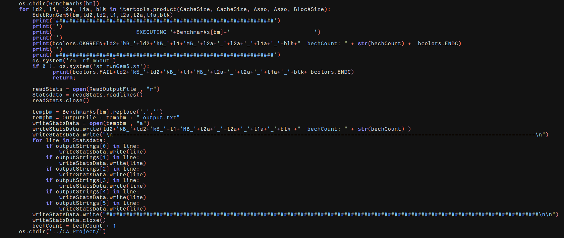
appendix
Python script for the automation and execution of both benchmarks

Slide 20
Thank You

